Slide 1
Intro to Linux
1st July 2015

Slide 2
UNIX
an OS first developed in the 1960s
has been under constant development ever since
most popular varieties are: Sun Solaris, GNU/Linux, and MacOS X
a UNIX OS is made up of three parts
Kernel; The kernel of UNIX is the hub of the OS: it allocates time and memory to programs and handles the filestore and communications in response to system calls,
Shell; The shell acts as an interface between the user and the kernel. The shell is a command line interpreter (CLI). It interprets the commands the user types in and arranges for them to be carried out,
and Programs; The commands are themselves also programs: when they terminate, the shell gives the user another prompt.

Slide 3
Files and processes
Everything in UNIX is either a file or a process.
A process is an executing program identified by a unique PID (process identifier).

Slide 4
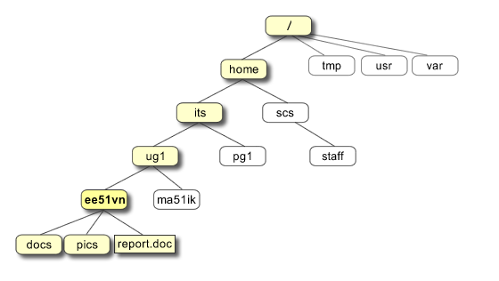
The Directory Structure

Slide 5
Paths
We are in the ‘its’ directory right now
We want to access ‘report.doc’
Relative
./ug1/ee51vn/report.doc
Absolute
/home/its/ug1/ee51vn/report.doc

Slide 6
Terminal Commands
ls //list files and directories
ls -a //list all files and directories
mkdir //make a directory
cd “directory” //change to named directory
cd //change to home-directory
cd ~ //change to home-directory
cd .. //change to parent directory
pwd //display the path of the current directory

Slide 7
More Terminal Commands
cp “file1” “file2” //copy file1 and call it file2
mv “file1” “file2” //move or rename file1 to file2
rm “file” //remove a file
rmdir “directory” //remove a directory
cat “file” //display a file
less “file” //display a file a page at a time
head “file” //display the first few lines of a file
tail “file” //display the last few lines of a file
grep 'keyword' “file” //search a file for keywords
wc “file” //count number of lines/words/characters in file
banner “anything” //prints a banner for “aything”

Slide 8
Redirection and Pipes
“command” > “file” //redirect standard output to a file
“command” >> “file” //append standard output to a file
“command” < “file” //redirect standard input from a file
“command1” | “command2” //pipe the output of command1 to the input of command2
cat “file1” “file2” > “file0” //concatenate file1 and file2 to file0
sort //sort data
who //list users currently logged in

Slide 9
Wildcards and help
* //match any number of characters
? //match one character
man “command” //read the online manual page for a command
whatis “command” //brief description of a command
apropos “keyword” //match commands with keyword in their man pages

Slide 10
File Access Rights
-rwxrwxrwx a file that everyone can read, write and execute (and delete).
-rw------- a file that only the owner can read and write - no-one else can read or write and no-one has execution rights (e.g. your mailbox file).
chmod

Slide 11
Special input
ls -lag //list access rights for all files
chmod [options] “file” //change access rights for named file
command & //run command in background
^C //kill the job running in the foreground
^Z //suspend the job running in the foreground
bg //background the suspended job
jobs //list current jobs
fg %1 //foreground job number 1
kill %1 //kill job number 1
ps //list current processes
kill 26152 //kill process number 26152
history

Slide 12
Compiling Source Code
The make command
allows programmers to manage large programs or groups of programs
aids in developing large programs by keeping track of which portions of the entire program have been changed, compiling only those parts of the program which have changed since the last compile
gets its set of compile rules from a text file called Makefile which resides in the same directory as the source files
The configure Shell Script
attempts to guess correct values for various system-dependent variables used during compilation
uses those values to create a Makefile in each directory of the package

Slide 13
Compiling Source Code
cd to the directory containing the package's source code.
Type ./configure to configure the package for your system.
Type make to compile the package.
Optionally, type make check to run any self-tests that come with the package.
Type make install to install the programs and any data files and documentation.
Optionally, type make clean to remove the program binaries and object files from the source code directory

Slide 14
File zipping
Gunzip
Tar
Bzip2
Example:
> gunzip sample.tar.gz
> tar -xvf sample.tar
> bzip2 -d sample.bz2

Slide 15
Environment Variables and Paths
http://www.ee.surrey.ac.uk/Teaching/Unix/unix8.html

Slide 16
Books
http://www.ee.surrey.ac.uk/Teaching/Unix/books-uk.html

